Slide 1
RNA-seq differential expression analysis
SciLifeLab RNA-seq workshop
March 14, 2017
Mikael Huss, SciLifeLab / Stockholm University, Sweden

Slide 2
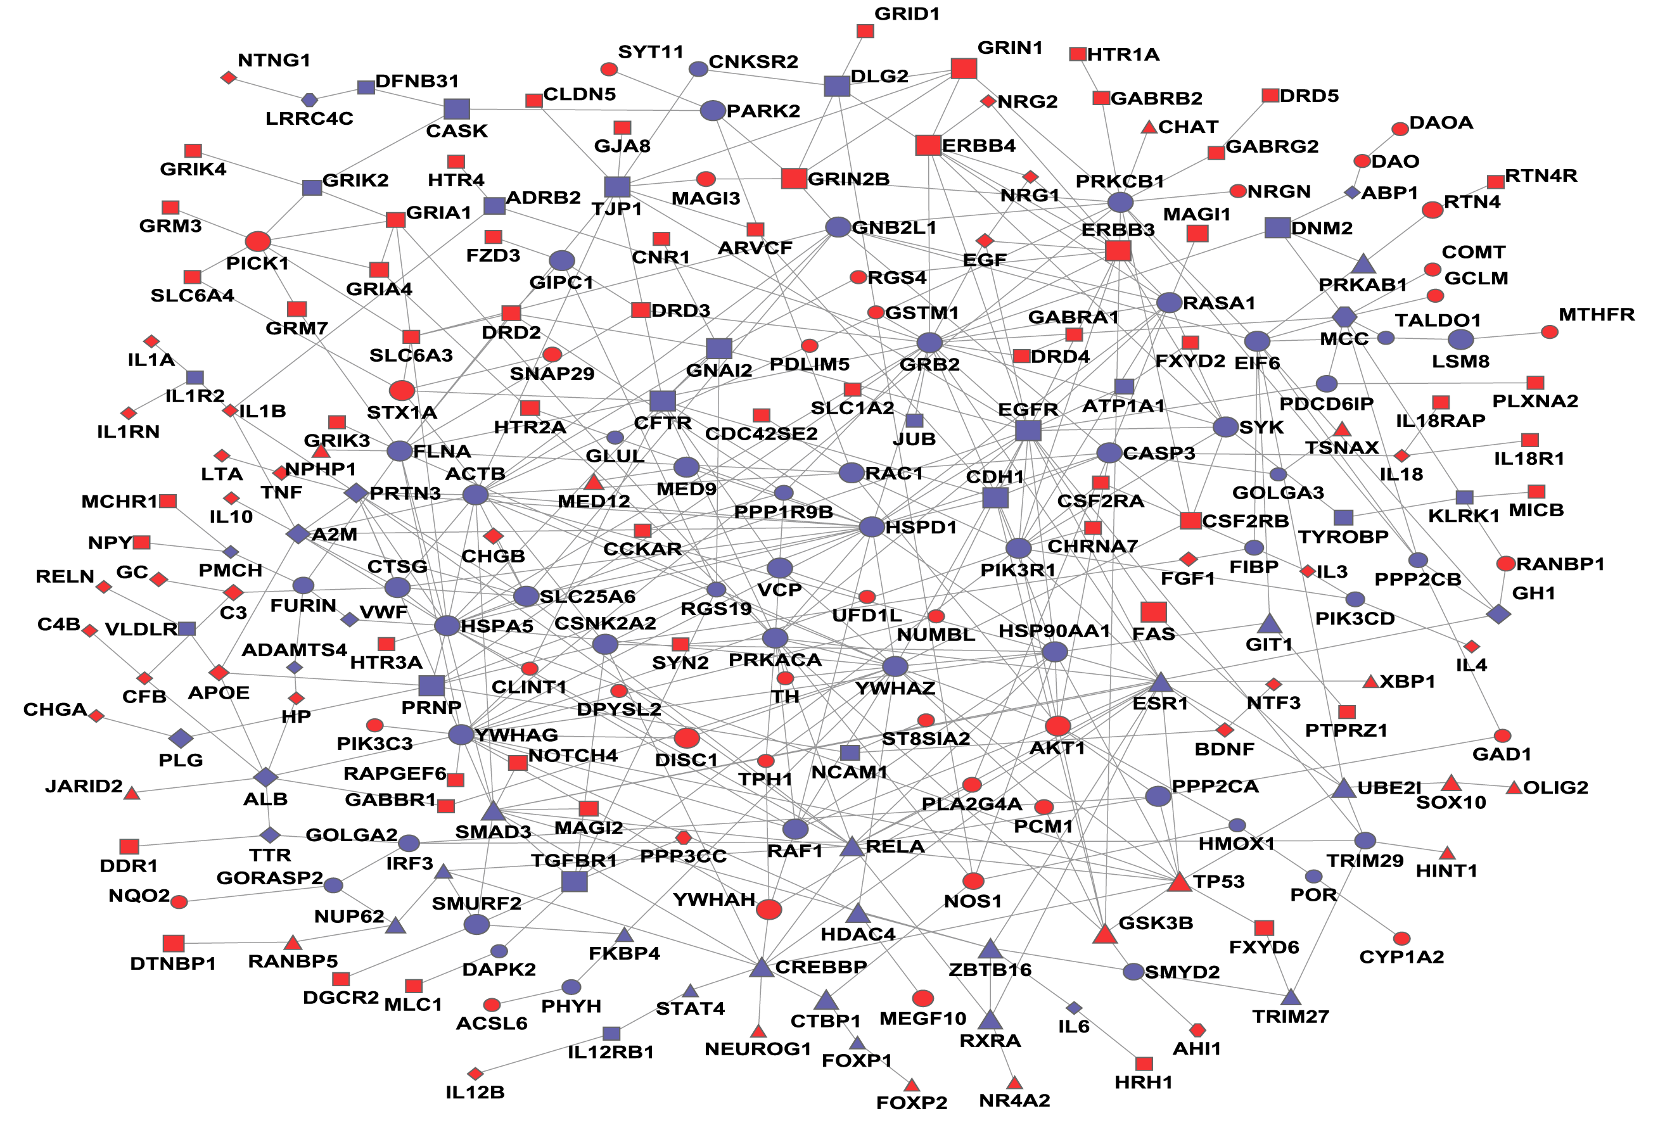
Differential expression analysis
The identification of genes (or other types of genomic features, such as transcripts or exons) that are expressed in significantly different quantities in distinct groups of samples, be it biological conditions (drug-treated vs. controls), diseased vs. healthy individuals, different tissues, different stages of development, or something else.
Typically univariate analysis (one gene at a time) – even though we know that genes are not independent

Slide 3
Some statistical aspects
Properties of RNA-seq data
Replicates

Slide 4
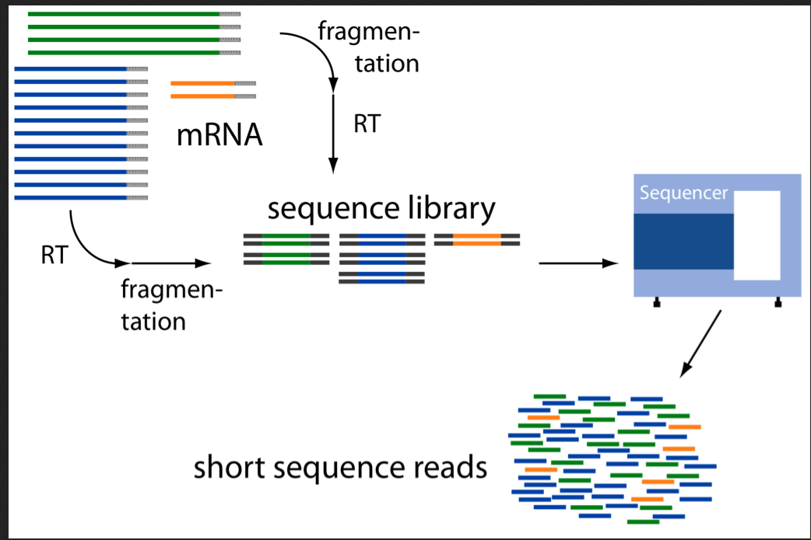
How are RNA-seq data generated?
Sampling process

Slide 5
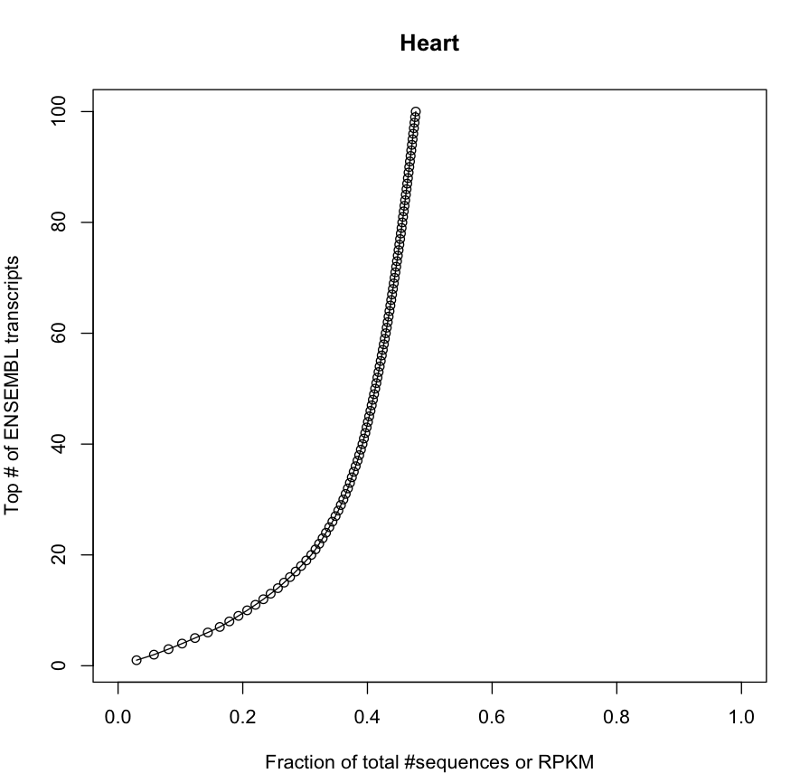
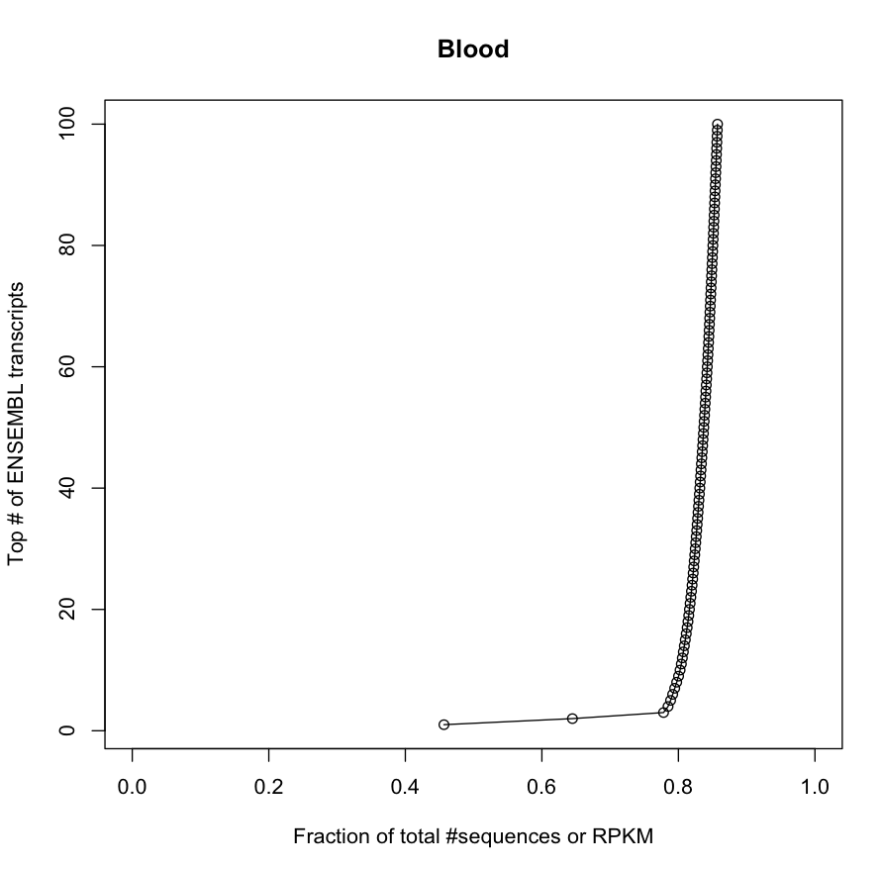
”Transcriptional real estate”

Slide 6
Count-based statistics
People often use discrete distributions (Poisson, negative binomial etc.) rather than continuous (e g normal) distributions for modeling RNA-seq data.
This is natural when you consider the way data are generated.
Thus, many DE analysis tools demand tables of integer read counts as input, rather than RPKM/FPKM/TPM.

Slide 7
Count nature of RNA-seq data
Programs like edgeR and DESeq2 want to make use of the count nature of RNA-seq data to increase statistical power. The reasoning goes something like this:
(simplified toy example!)
Scenario 1: A 30000-bp transcript has 1000 counts in sample A and 700 counts in sample B.
Scenario 2: A 300-bp transcript has 10 counts in sample A and 7 counts in sample B.
Assume that the sequencing depths are the same in both samples and both scenarios. Then the RPKM is the same in sample A in both scenarios, and in sample B in both scenarios.
In scenario A, we can be more confident that there is a true difference in the expression level than in scenario B (although we would want replicates of course!) by analogy to a coin flip – 600 heads out of 1000 trials gives much more confidence that a coin is biased than 6 heads out of 10 trials

Slide 8
Technical vs biological replicates
Technical replicates:
Assess variability of measurement technique
Typically low for bulk RNA-seq (not necessarily single-cell RNA-seq)
Poisson distribution can model variability between RNA-seq technical replicates rather well
Biological replicates:
Assess variability between individuals / “normal” biological variation
Necessary for drawing conclusions about biology
Variability across RNA-seq biological replicates not well modelled by Poisson – usually negative binomial (“overdispersed Poisson”) is used

Slide 9
Replicates and differential expression
Intuitively, the variation between the groups that you want to compare should be large compared to the variation within each group to be able to say that we have differential expression.
The more biological replicates, the better you can estimate the variation. But how many replicates are needed?
Depends:
Homogeneous cell lines, inbred mice etc: maybe 3 samples / group enough.
Clinical case-control studies on patients: can need a dozen, hundreds or thousands, depending on the specifics ….

Slide 10
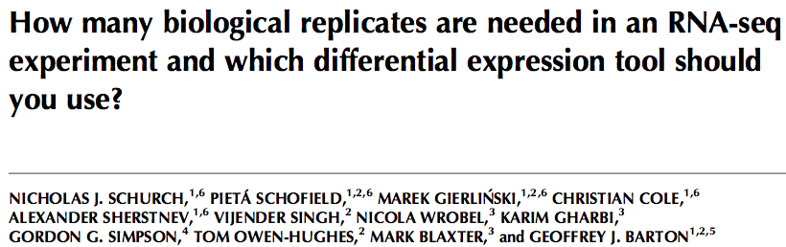
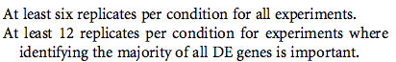
RNA 22:1–13, 2016
48 wild-type and 48 mutant (snf2 deletion) biological replicates in yeast
(well studied, relatively small genome, few multi-exonic genes => should be a relatively “simple” case)
Recommendation:

Slide 11
Different software packages and choices
Mapping vs pseudo-alignment
Parametric vs non-parametric
Isoform-level vs gene-level
Complex vs simple comparisons

Slide 12
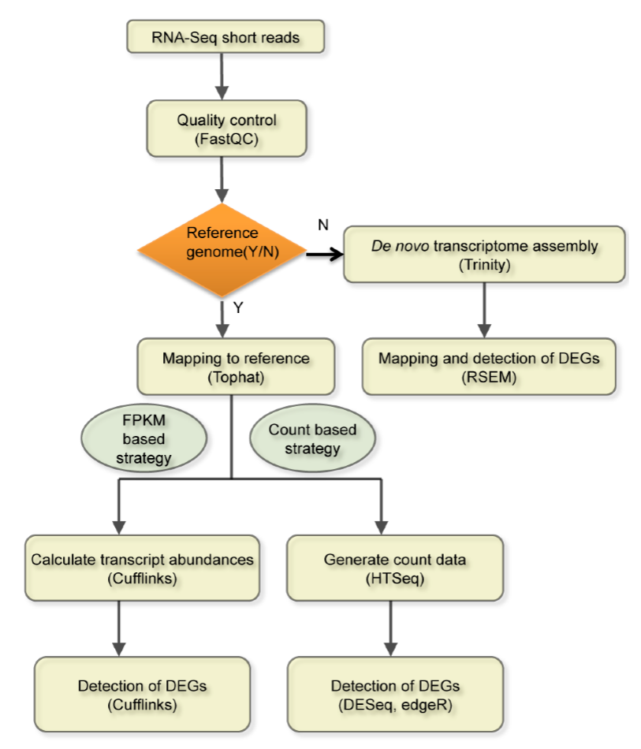
Possible workflows
Or BitSeq, eXpress, RSEM, Sailfish etc.
Or BitSeq, ebSeq etc.
Or SAMSeq, limma, etc.

Slide 13
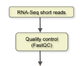
Alternative - Kallisto/Sleuth “pipeline”:
Pseudo-alignment + transcript-centric quantification and DE analysis
Map to reference
transcriptome (Kallisto)
- Build an index by chopping ref transcriptomes into k-mers and putting them into “colored” graphs
Differential expression analysis with Sleuth
CAG
AGG
GGA
TCA
GAC
GTC
CGA
TCG

Slide 14
Kallisto/Sleuth “pipeline”:
Pseudo-alignment + transcript-centric quantification and DE analysis
Map to reference
transcriptome (Kallisto)
Differential expression analysis with Sleuth
CAG
AGG
GGA
TCA
GAC
When a new read is observed, chop it into k-mers and see what it is compatible with. E g observe TCGA:
TCGA
TCGA
GTC
CGA
TCG

Slide 15
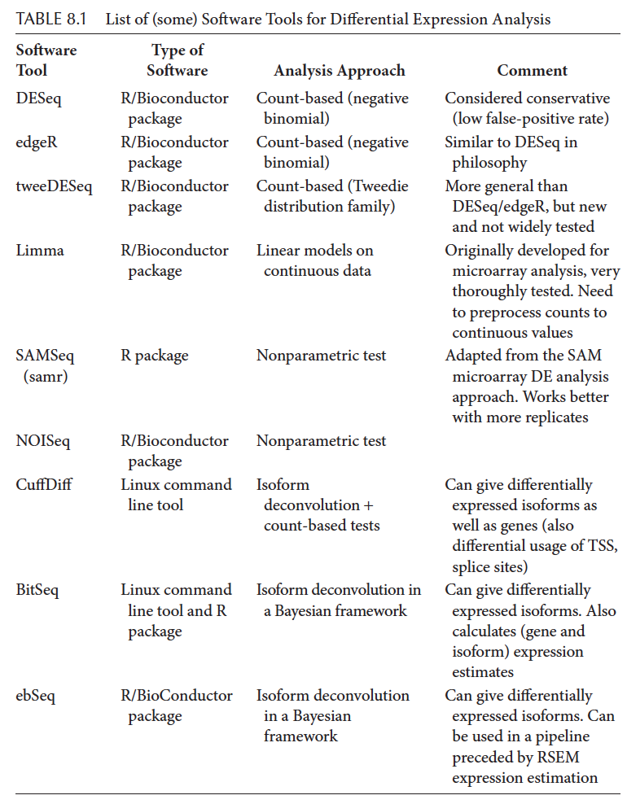

Slide 16
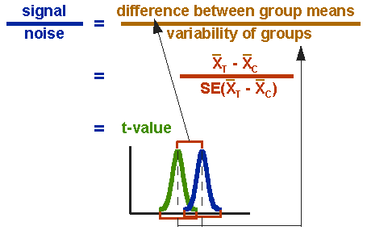
Differential expression analysis?
Couldn’t we just use a Student’s t test for each gene?
Problems with this approach:
- May have few replicates
- Multiple testing issues
- Distribution is not normal
http://www.socialresearchmethods.net/kb/stat_t.php

Slide 17
Dealing with the “t test issues”
Variance estimation issue: edgeR, DESeq2 and limma (in slightly different ways) “borrow” information across genes to get a better variance estimate. One says that the estimates “shrink” from gene-specific estimates towards a common mean value.

Slide 18
Dealing with the “t test issues”
Variance estimation issue: edgeR, DESeq2 and limma (in slightly different ways) “borrow” information across genes to get a better variance estimate. One says that the estimates “shrink” from gene-specific estimates towards a common mean value.
Multiple testing issue: All of these packages report q values or some other type of false discovery rate corrected p values. For SAMseq based on resampling, for others usually Benjamini-Hochberg corrected p values.

Slide 19
Dealing with the “t test issues”
Variance estimation issue: edgeR, DESeq2 and limma (in slightly different ways) “borrow” information across genes to get a better variance estimate. One says that the estimates “shrink” from gene-specific estimates towards a common mean value.
Multiple testing issue: All of these packages report q values or some other type of false discovery rate corrected p values. For SAMseq based on resampling, for others usually Benjamini-Hochberg corrected p values.
Distributional issue: Solved by variance stabilizing transform in limma – voom() function
edgeR and DESeq model the count data using a negative binomial distribution and use their own modified statistical tests based on that.

Slide 20
Parametric vs. non-parametric methods
It would be nice to not have to assume anything about the expression value distributions but only use rank-order statistics. -> methods like SAM (Significance Analysis of Microarrays) or SAM-seq (equivalent for RNA-seq data)
However, it is (typically) harder to show statistical significance with non-parametric methods with few replicates.
According to Simon Anders (creator of DESeq) non-parametric methods are definitely better with 12 replicates and maybe already at five
http://seqanswers.com/forums/showpost.php?p=74264&postcount=3
… but ...

Slide 21
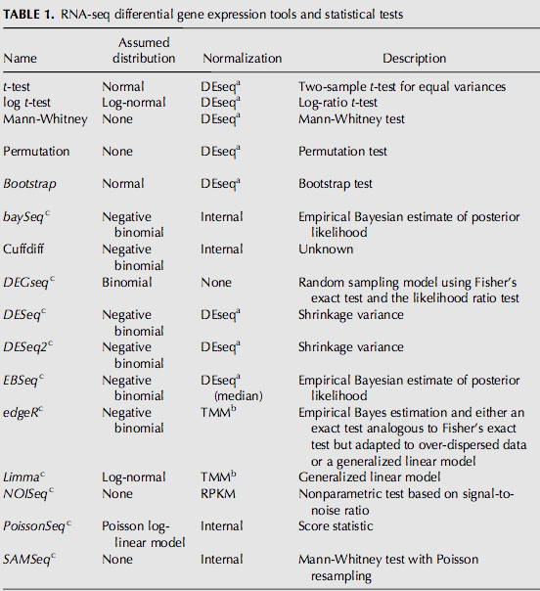
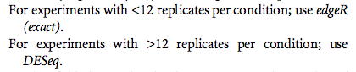
But: Revisiting the 48-replicate benchmark paper
Parametric methods apparently working better …

Slide 22
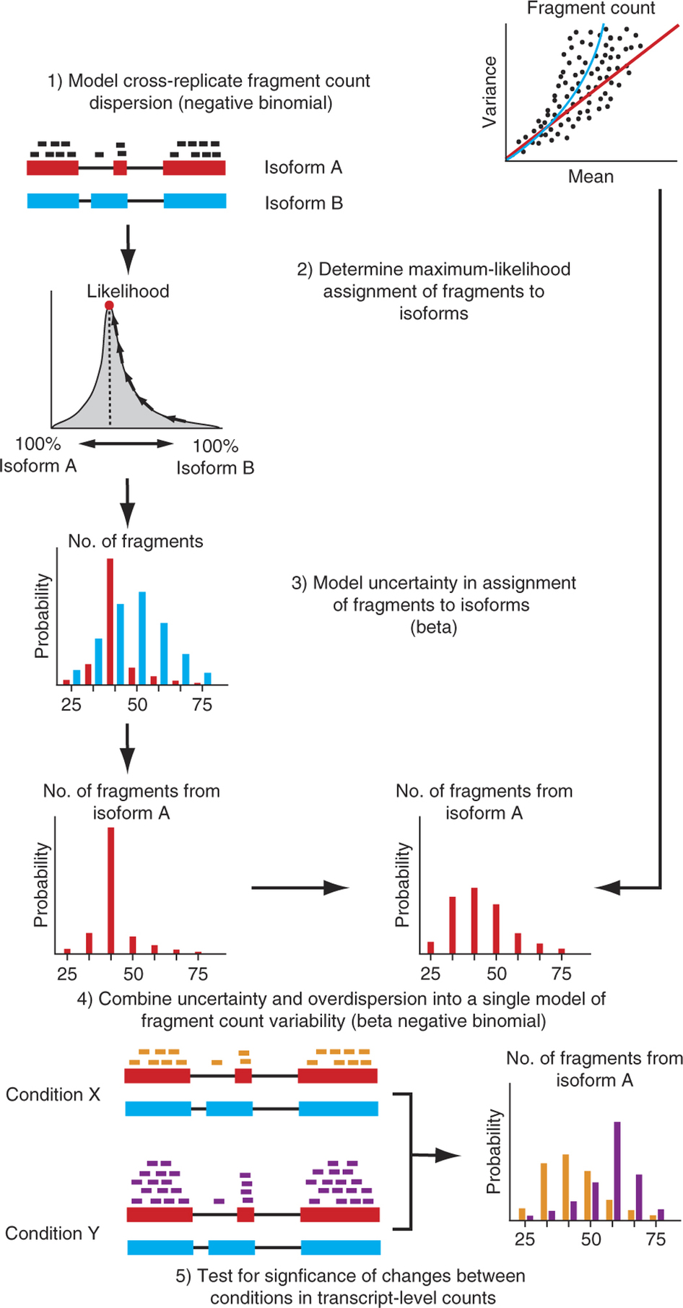
CuffDiff2
Integrates isoform quantification + differential expression analysis.
Also: BitSeq

Slide 23
Sleuth
Developed by the same team as CuffDiff, and superior to it according to them. Based on Kallisto.
Transcript-oriented (like CuffDiff)
Includes uncertainty coming from “quantification noise” (like CuffDiff)
Supports modelling multiple experimental factors (unlike CuffDiff)

Slide 24
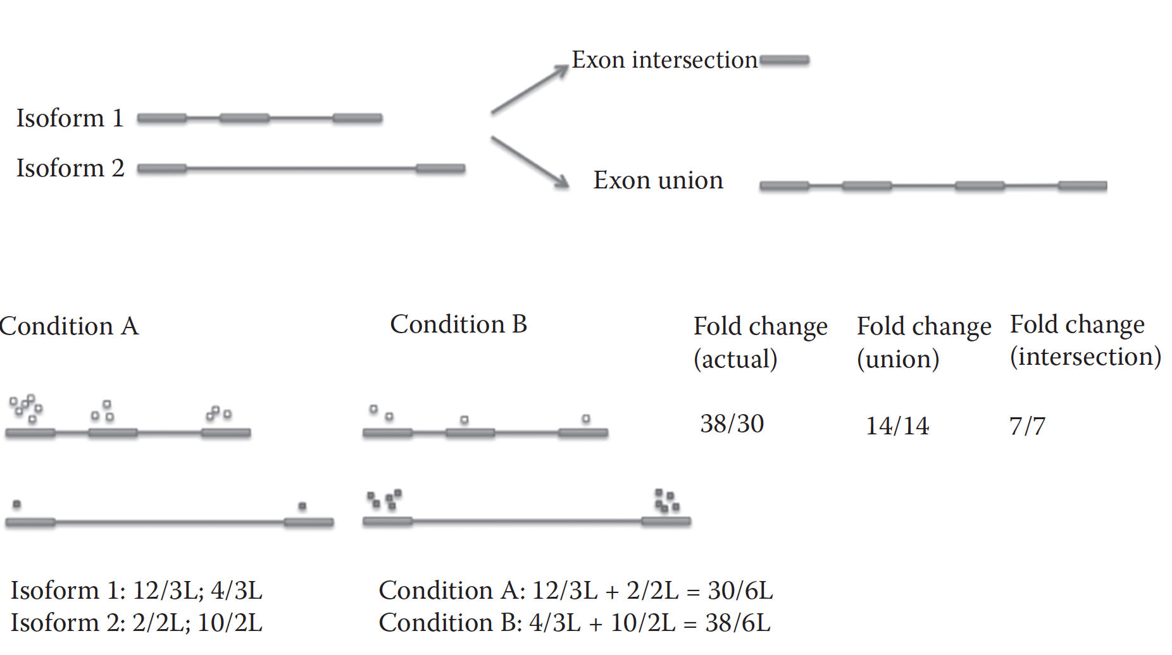
Reason to use transcript-level analysis counting can hide DE

Slide 25
Complex designs
The simplest case is when you just want to compare two groups against each other.
But what if you have several factors that you want to control for?

Slide 26
Complex designs
The simplest case is when you just want to compare two groups against each other.
But what if you have several factors that you want to control for?
E.g. you have taken tumor samples at two different time points from six patients, cultured the samples and treated them with two different anticancer drugs and a mock control treatment. -> 2x6x3 = 36 samples.

Slide 27
Complex designs
The simplest case is when you just want to compare two groups against each other.
But what if you have several factors that you want to control for?
E.g. you have taken tumor samples at two different time points from six patients, cultured the samples and treated them with two different anticancer drugs and a mock control treatment. -> 2x6x3 = 36 samples.
Now you want to assess the differential expression in response to one of the anticancer drugs, drug X. You could just compare all “drug X” samples to all control samples but the inter-subject variability might be larger than the specific drug effect.

Slide 28
Complex designs
The simplest case is when you just want to compare two groups against each other.
But what if you have several factors that you want to control for?
E.g. you have taken tumor samples at two different time points from six patients, cultured the samples and treated them with two different anticancer drugs and a mock control treatment. -> 2x6x3 = 36 samples.
Now you want to assess the differential expression in response to one of the anticancer drugs, drug X. You could just compare all “drug X” samples to all control samples but the inter-subject variability might be larger than the specific drug effect.
limma / DESeq / edgeR / Sleuth which can work with factorial designs
(but not e g CuffDiff2, SAMSeq)

Slide 29
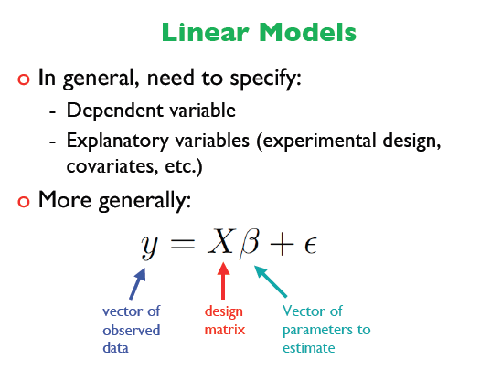
Limma and factorial designs
limma stands for “linear models for microarray analysis” – but it can be used for RNA-seq after applying voom() to a count matrix
Essentially, the expression of each gene is modeled with a linear relation
http://www.math.ku.dk/~richard/courses/bioconductor2009/handout/19_08_Wednesday/KU-August2009-LIMMA/PPT-PDF/Robinson-limma-linear-models-ku-2009.6up.pdf
The design matrix describes all the conditions, e g treatment, patient, time etc
y = a + b*treatment + c*time + d*patient + e*batch + f
Baseline/average
Error term/noise

Slide 30
Which software to choose?
Based on need
Benchmarks

Slide 31
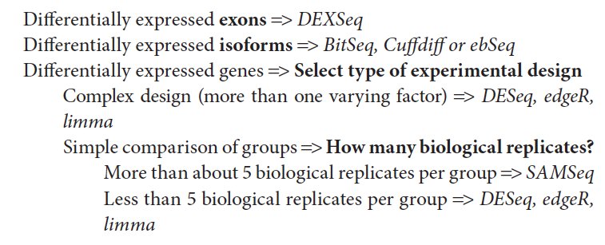
Decision tree for software selection (2015)

Slide 32
Decision tree for software selection (2016)
Sleuth
, Sleuth
?

Slide 33
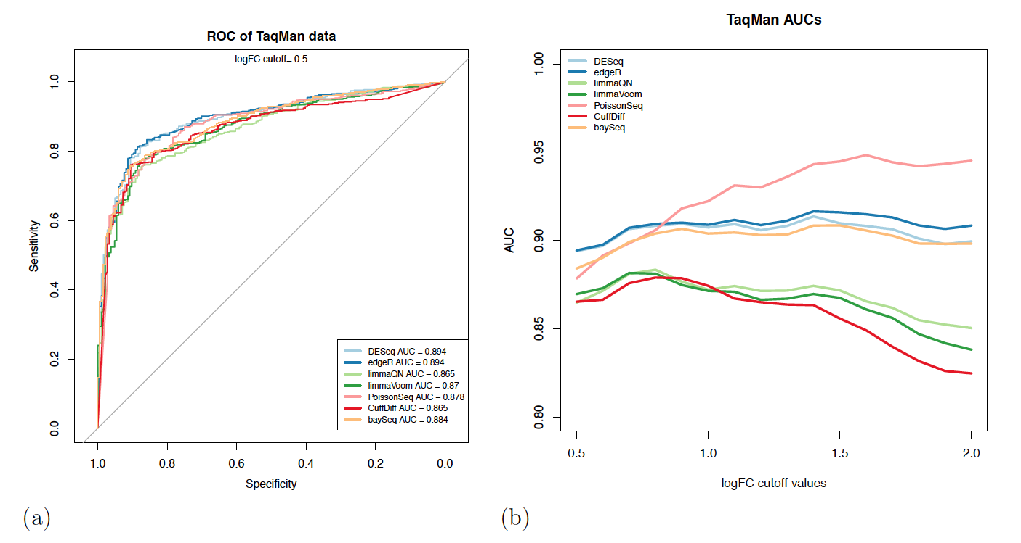
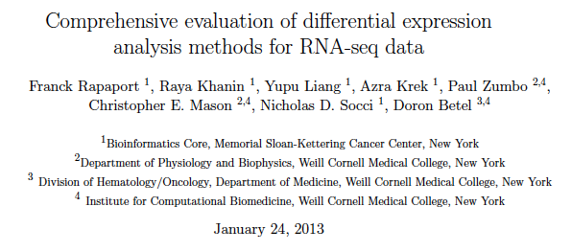
Other DE software comparisons (1)
DESeq, edgeR, PoissonSeq come out well

Slide 34
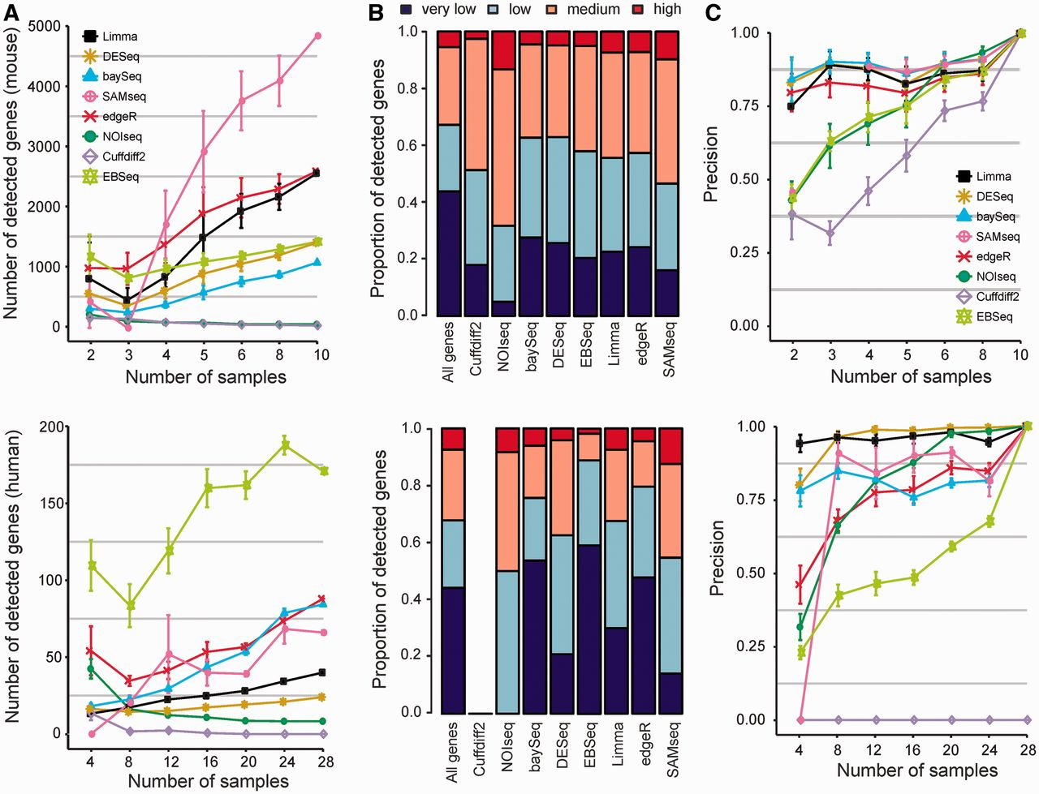
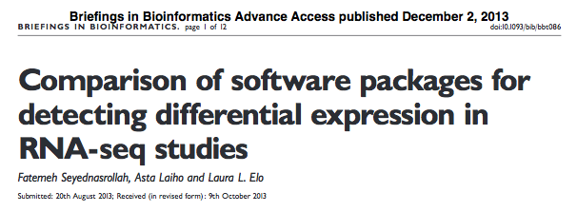
Other DE software comparisons (2)
Limma, DESeq, baySeq

Slide 35
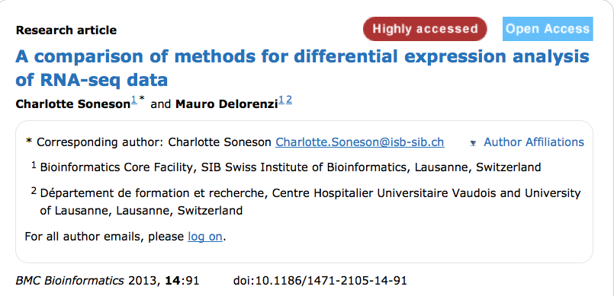
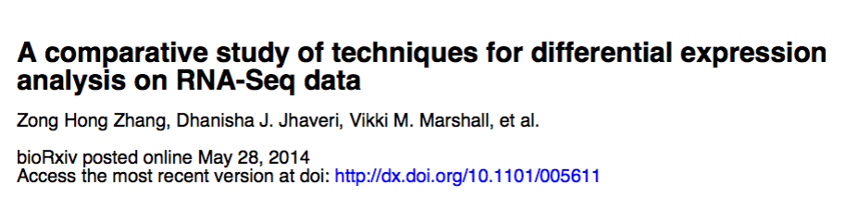
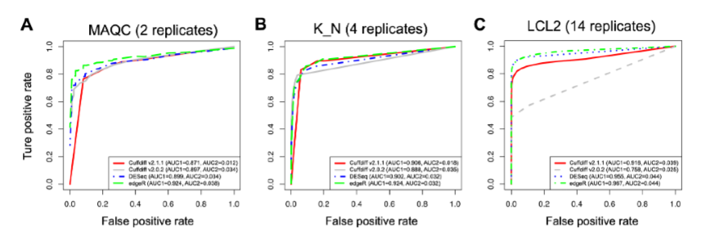
Other DE software comparisons (3-4)
Nice code examples in supplementary material: R code for all tested packages
edgeR, DESeq

Slide 36
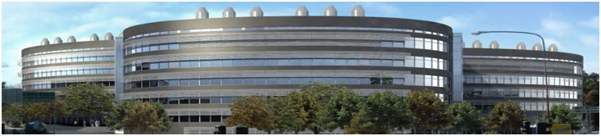
Take-away messages from DE tool comparison
edgeR, DESeq and limma (the latter of which does not use the negative binomial distribution) tend to to work well
CuffDiff2, which should theoretically be “better”, seems to work worse, perhaps due to the increased “statistical burden” from isoform expression estimation. Two studies also report poor performance with >5 replicates
The HTSeq quantification which is theoretically “wrong” seems to give good results with downstream software
It is practically always better to sequence more biological replicates than to sequence the same samples deeper
Not considered in these comparisons:
- gains from ability to do complex designs
- isoform-level DE analysis (hard to establish ground truth)
- some packages like BitSeq, Sleuth

Slide 37
Miscellaneous (if there is time)
Batch normalization
Mixtures of cell types
Visualization of DE analysis results
Normalization and scaling
Beyond univariate DE analysis

Slide 38

Batch normalization
Often, putting the experimental batch as a factor in the design matrix is enough.
If you wish to explicitly normalize away the batch effects (to get a new, batch-normalized expression matrix with continuous values), you can use a method such as ComBat.
(Designed for microarrays, should use log scale values for RNA-seq)
Johnson, WE, Rabinovic, A, and Li, C (2007). Adjusting batch effects in microarray expression data using Empirical Bayes methods. Biostatistics 8(1):118-127.

Slide 39
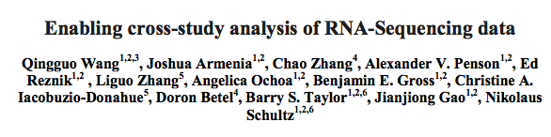
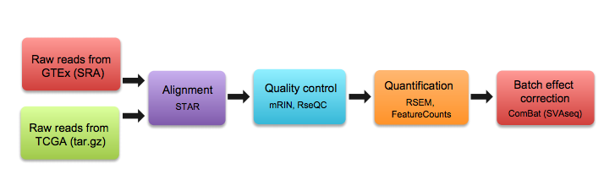
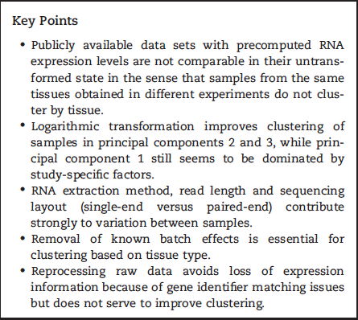
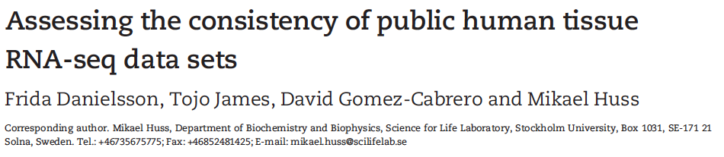
Recent preprint
http://biorxiv.org/content/early/2017/02/27/110734
But see also 2015 paper

Slide 40
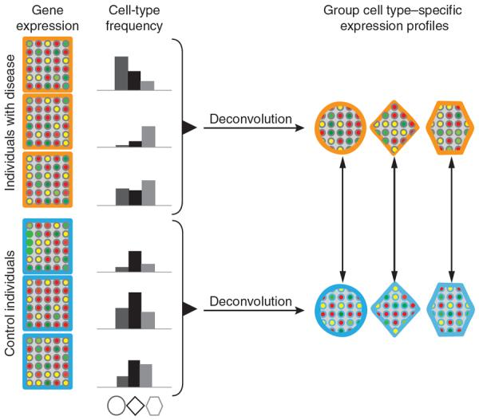
DE analysis in mixtures of cell types
CellMix, R package implementing several deconvolution methods (most for microarray)
Gaujoux R, Seoighe C. CellMix: a comprehensive toolbox for gene expression
deconvolution. Bioinformatics. 2013 Sep 1;29(17):2211-2. doi:
10.1093/bioinformatics/btt351.
Shen-Orr SS, Tibshirani R, Khatri P, Bodian DL, Staedtler F, Perry NM, Hastie
T, Sarwal MM, Davis MM, Butte AJ. Cell type-specific gene expression differences
in complex tissues. Nat Methods. 2010 Apr;7(4):287-9.

Slide 41
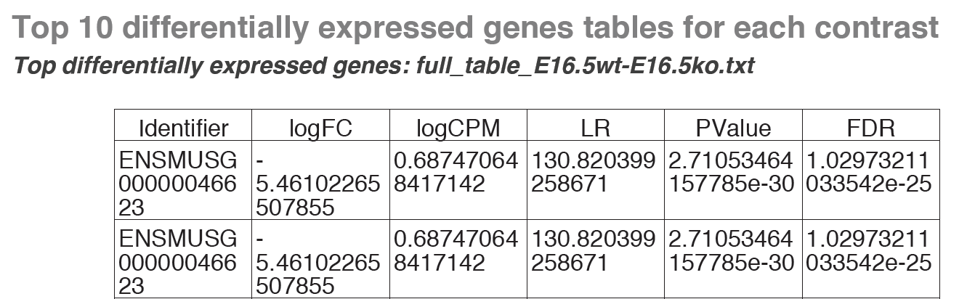
Differential expression analysis output
(and so on …)
Log fold change, FDR
How to visualize?

Slide 42
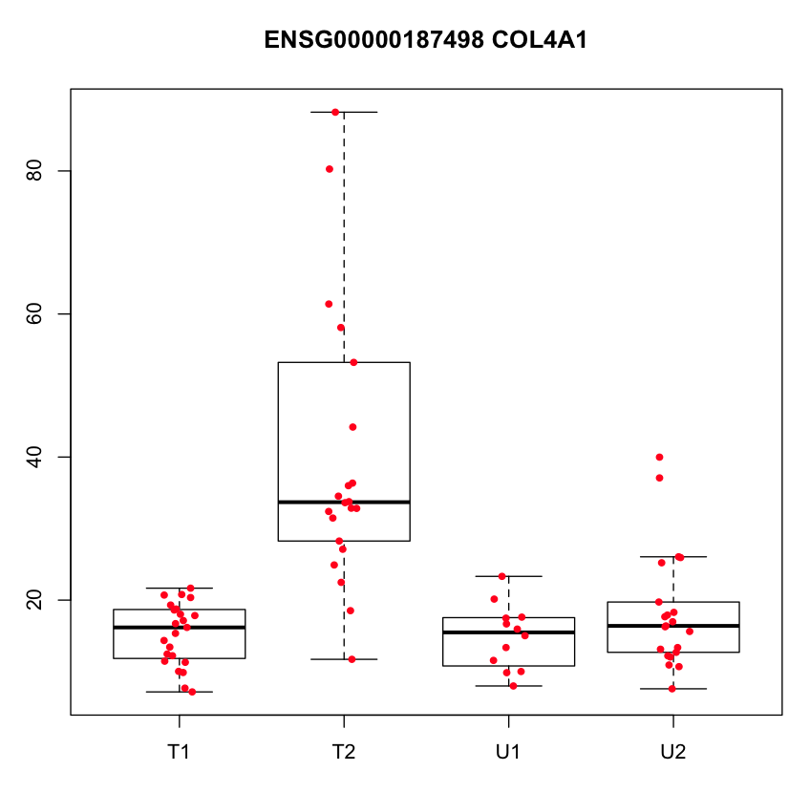
Looking at top genes one by one
Box plot

Slide 43
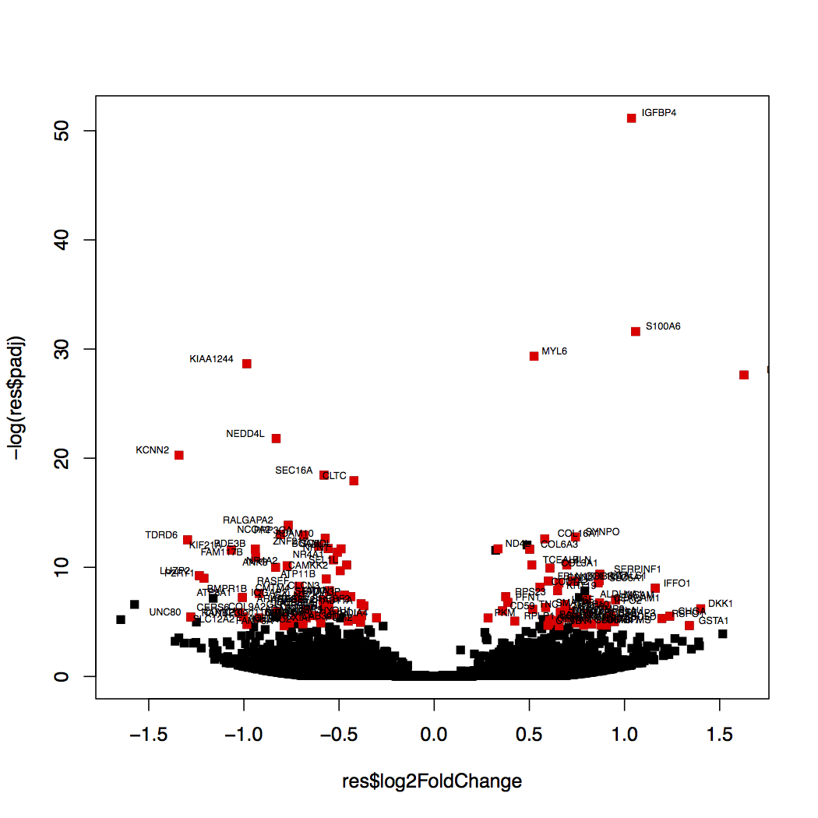
More global view
Volcano plot

Slide 44
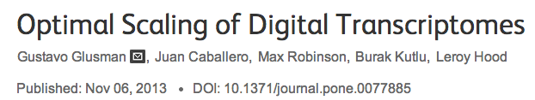
Normalization/scaling/transformation: different goals
R/FPKM: (Mortazavi et al. 2008)
Correct for: differences in sequencing depth and transcript length
Aiming to: compare a gene across samples and diff genes within sample
TMM: (Robinson and Oshlack 2010)
Correct for: differences in transcript pool composition; extreme outliers
Aiming to: provide better across-sample comparability
TPM: (Li et al 2010, Wagner et al 2012)
Correct for: transcript length distribution in RNA pool
Aiming to: provide better across-sample comparability
Limma voom (logCPM): (Lawet al 2013)
Aiming to: stabilize variance; remove dependence of variance on the mean

Slide 45
TMM – Trimmed Mean of M values
Attempts to correct for differences in RNA composition between samples
E g if certain genes are very highly expressed in one tissue but not another, there will be less “sequencing real estate” left for the less expressed genes in that tissue and RPKM normalization (or similar) will give biased expression values for them compared to the other sample
RNA population 1
RNA population 2
Equal sequencing depth -> orange and red will get lower RPKM in RNA population 1 although the expression levels are actually the same in populations 1 and 2
Robinson and Oshlack Genome Biology 2010, 11:R25, http://genomebiology.com/2010/11/3/R25

Slide 46
Normalization in DE analysis
edgeR, DESeq2 and some others want to keep the (integer) read counts in the DE testing because they
Use a discrete statistical model
Want to retain statistical power (see next slide)
… but they implicitly normalize (by TMM in edgeR and RLE in DESeq2) as part of the DE analysis.
Programs like SAMSeq and limma are fine with continuous values (like FPKM), the former because it has a rank based model and the latter because it cares more about the mean-variance relationship being weak. They also apply their own types of normalization as part of the DE testing.

Slide 47
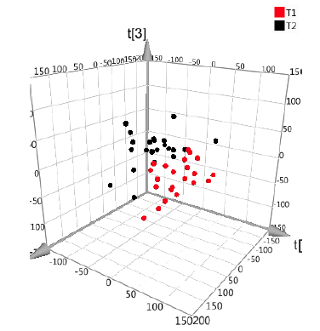
Beyond univariate differential expression (1)
Multivariate methods such as PCA (unsupervised) or PLS (supervised) can be used to obtain loadings for features (genes/transcripts/…) that contribute to separation of groups
The loading scores can be used as a different kind of measure of which genes are interesting

Slide 48
Beyond univariate differential expression (2)
Statistical/machine learning approaches:
Can use gene or transcript expression levels as features in a statistical model when trying to predict some class (classification) or continuous variable (regression)
Feature selection methods frequently needed to reduce the number of genes/transcripts used in the model. E g lasso/elastic net or Boruta (random forest based feature selection).

